Slide 1
TREE OF LIFE
Arboles de la Vida

Slide 10
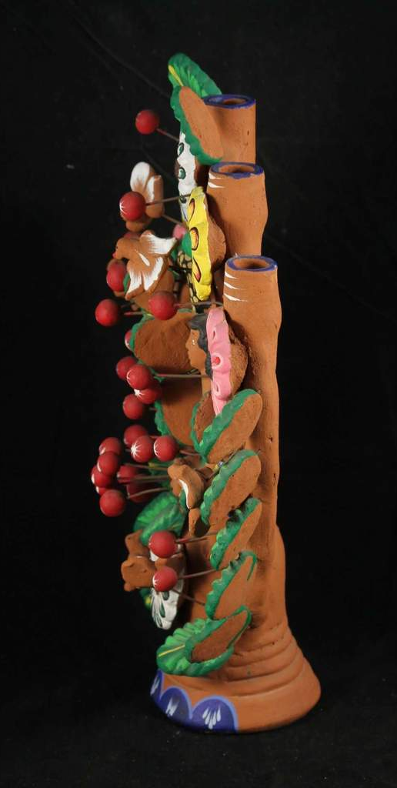

Slide 12
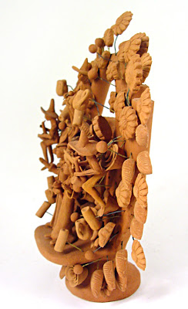

Slide 21
VERONICA CASTILLO WORKING: https://www.pbs.org/video/craft-america-veronica-castillo-builds-tree-life-assembling/

